Slide 1
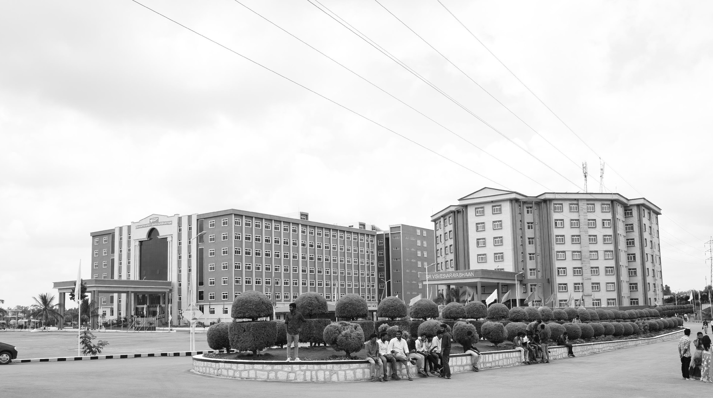

HEALTH MONITORING SYSTEM FOR AUTOMOBILES(ENGINE PARAMETERS)
AY 2020-24
GITAM UNIVERSITY
Major Project
Project ID: V17
A University should be a place of light, of liberty, and of learning.
Department of Electrical Electronics and Communication Engineering
Project Team:
K. SOWMYA
R. MOKSHITHA
M. LOK VIGNESH
Project Mentor:
www.gitamedu.com

Slide 2




Project Group – Details
Photo
Track
Roll No
Name
EECE AI/ML
BU21EECE0100099
M. LOK VIGNESH
EECE AI/ML
BU21EECE0100160
R. MOKSHITHA
EECE AI/ML
BU21EECE0100475
K. SOWMYA

Slide 3
Objective and Goals
Objective
Condition Of Engine(parameters- Engine RPM, Lub. Oil pressure, Fuel pressure, Coolant pressure, Lub. Oil temperature, Coolant pressure.
Improve Vehicle Reliability and Safety
Optimize Vehicle/Engine Performance and Efficiency
Reduce Maintenance Costs
Enhance Customer Satisfaction
Goals
Main Goals
Reduce breakdowns, increase uptime, enhance driver safety, and minimize accident risks.
Improve fuel efficiency, enhance engine performance, and reduce emissions.
Enable predictive maintenance, optimize maintenance schedules, and reduce overall costs.
Provide peace of mind, improve customer loyalty, and offer personalized maintenance recommendations.
Additional Goals
Provide features that allow owners to remotely monitor and control their vehicles
Incorporate technologies like autonomous emergency braking, lane departure warning, and blind spot monitoring.
Use eco-friendly materials in vehicle construction.
Offer personalized maintenance plans and services based on individual driving habits and preferences.

Slide 4
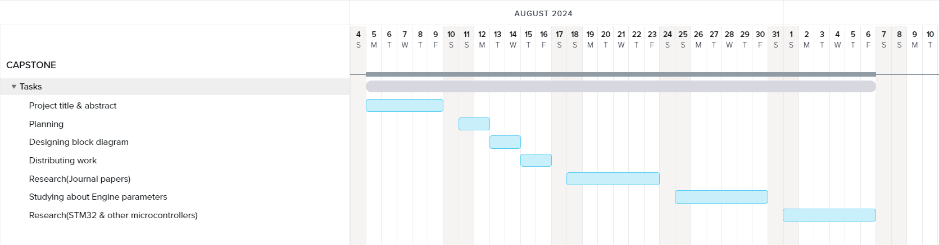
Project Plan
Gant Chart - Milestones and Activities

Slide 5
Literature Survey
Key Publications
Nithish Kanna J L Krishnakumar G, Muhammad Aadhil M, Dr. Ajay V P “Predictive Maintenance of Motors using Machine Learning”, Kumaraguru College of Technology.
H.E.G. Po~e and C.E. Fisher “Engine Health Monitoring: Towards Total Prognostics ”, United Kingdom.
Ryan Ahmed, Mohammed El Sayed, S. Andrew Gadsden, Jimi Tjong, and Saeid Habibi “Automotive Internal-Combustion-Engine Fault Detection and Classification Using Artificial Neural Network Techniques”, 2015.
Key Resources – Whitepaper| Application Notes | Datasheet| Others
Predictive Maintenance for Automotive
The Future of Automotive Health Monitoring
Application Note: Implementing a Real-Time Health Monitoring System for Electric Vehicles
IoT Gateway for Vehicle Health Data Collection
Existing Implementations – Products| Opensource| GitHub etc
Bosch Automotive
Continental
Vehicle Health Monitoring Platform (VHMP)
Predictive Maintenance for Automotive Engines
IoT-based Vehicle Health Monitoring

Slide 6
Analysis - SWOT
Strengths
Weaknesses
Advanced sensor technology: The availability of accurate and reliable sensors for measuring engine parameters.
Data analytics capabilities: The ability to process and analyze large amounts of data to identify patterns and anomalies.
Predictive maintenance potential: The potential to prevent breakdowns and reduce maintenance costs through early detection of issues.
Improved safety: The ability to identify and address potential safety hazards related to engine malfunctions.
Enhanced customer satisfaction: The potential to improve customer satisfaction by providing peace of mind and reducing vehicle downtime.
Data privacy concerns: The collection and storage of sensitive vehicle data raises privacy concerns.
Complexity of integration: Integrating a health monitoring system with existing vehicle electronics can be complex.
Dependency on technology: The system's effectiveness relies on the reliability and accuracy of sensors and data analytics algorithms.
Potential for false positives or negatives: The system may generate false alarms or fail to detect certain issues.
Opportunities
Threats
Growing demand for connected vehicles: The increasing popularity of connected vehicles presents opportunities for integrating health monitoring systems with other vehicle features.
Advancements in machine learning: Improvements in machine learning algorithms can enhance the accuracy and reliability of predictive maintenance models.
New business models: The development of new business models based on health monitoring data, such as usage-based insurance or predictive maintenance services.
Regulatory requirements: The increasing emphasis on vehicle safety and emissions regulations may drive the adoption of health monitoring systems.
Competitive pressures: The emergence of competing technologies or business models may erode the market position of health monitoring systems.
Economic downturns: Economic downturns may reduce consumer demand for advanced vehicle features, including health monitoring systems.
Regulatory changes: Changes in regulations or standards may impact the design and implementation of health monitoring systems.

Slide 7
Analysis – 4W1H
Why:
Early detection of engine issues can prevent costly repairs and breakdowns.
Monitoring critical parameters can identify potential safety hazards, such as overheating or oil pressure loss.
Optimizing engine performance through real-time data can lead to better fuel economy.
What:
A system that continuously monitors and records key engine parameters: Engine RPM, Lubricating Oil Pressure, Fuel Pressure, Coolant Pressure, Lubricating Oil Temperature, and Coolant Temperature.
A user interface (dashboard or app) to display real-time data and generate alerts for abnormal conditions.
Integration with existing vehicle systems (e.g., OBD-II) for data collection and communication.
Where: This system can be installed in a variety of vehicles, including passenger cars, trucks, and commercial vehicles.
When: The system should operate continuously while the vehicle is in use. Data can be stored and analyzed for trend analysis and predictive maintenance.
How:
Refined Objective: To develop a robust and cost-effective health monitoring system for automobiles that accurately measures critical engine parameters, provides real-time data visualization, and generates timely alerts to prevent breakdowns, enhance safety, and optimize vehicle performance.
Utilize sensors to measure engine parameters.
Implement data acquisition and processing units to collect and analyze data.
Develop a user interface to display real-time data and generate alerts.
Consider cloud-based solutions for data storage and remote monitoring

Slide 8
Architecture
Structural Diagram
Block Diagram/Pin Diagram
Resource - https://www.lucidchart.com/pages/examples/uml_diagram_tool
Behaviour Diagram
Flow chart/ State machine
Resource - https://www.lucidchart.com/pages/examples/uml_diagram_tool

Slide 9
Use Cases & Testing
Use Cases
Xx
Xx
X
X
Test Cases
XX
XX
XX

Slide 10
Implementation and Results – Iteration 1
Iteration 1 : Results

Slide 11
Implementation and Results – Iteration 2
Iteration : Results + Validation against the usecases and test cases

Slide 12
Implementation and Results – Iteration 3 (Optional)
Iteration : Results + Validation against the usecases and test cases

Slide 13
Contribution
Team Progress and Movement
Xx
Xx
X
X
Individual Contribution
Key contributions: Team Member Name
XX
XX
Key contributions: Team Member Name
XX
XX
Key contributions: Team Member Name
XX
XX
Key contributions: Team Member Name
XX
XX
Key contributions: Team Member Name
XX
XX

Slide 14
Conclusion & Future Work
Summary and Conclusion
Future Work

Slide 15

THANK YOU

